Slide 1
Match Five!
Questions…

Slide 2
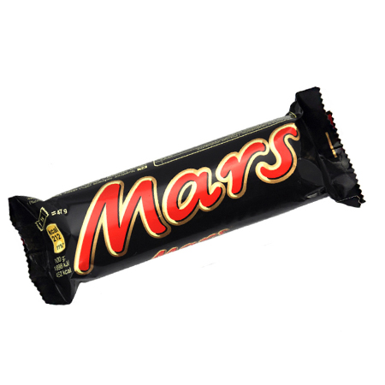
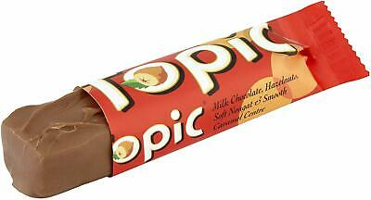
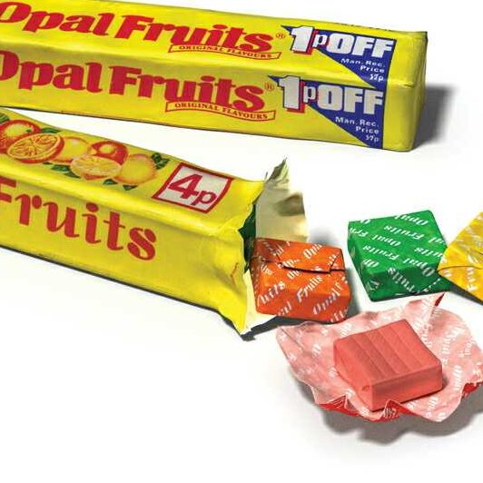
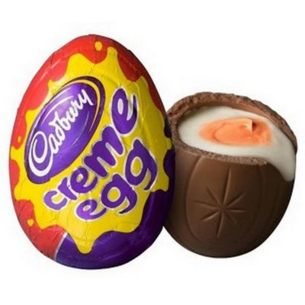
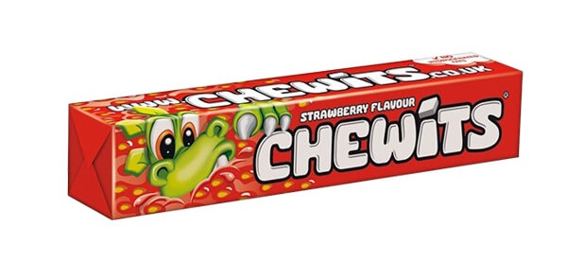
01. Confectionary slogans
A
B
1 A hazelnut in every bit
2 Even Chewier than Barrow in Furness Bus Depot
3 Helps you work rest and play
4 How do you eat yours?
5 Made to make your mouth water
C
1 A
2 C
3 B
4 E
5 D
D
E

Slide 3



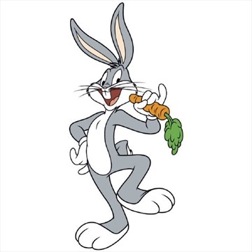

02. Animation Studios
B
1 Disney
2 Hanna-Barbera
3 Metro-Goldwyn-Mayer
4 TerryToons
5 Warner Bros
A
C
1 C
2 A
3 D
4 E
5 B
D
E

Slide 4
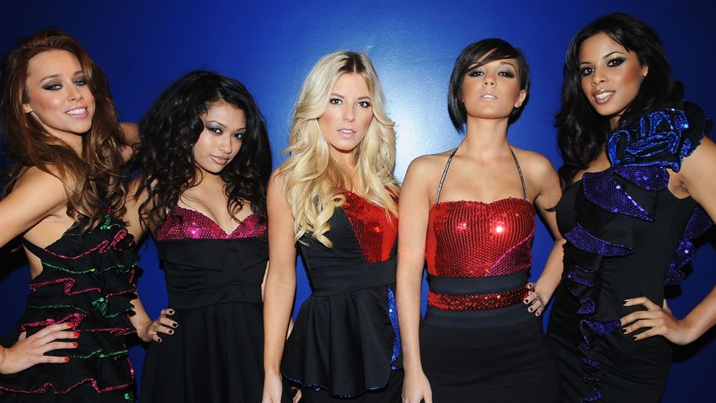
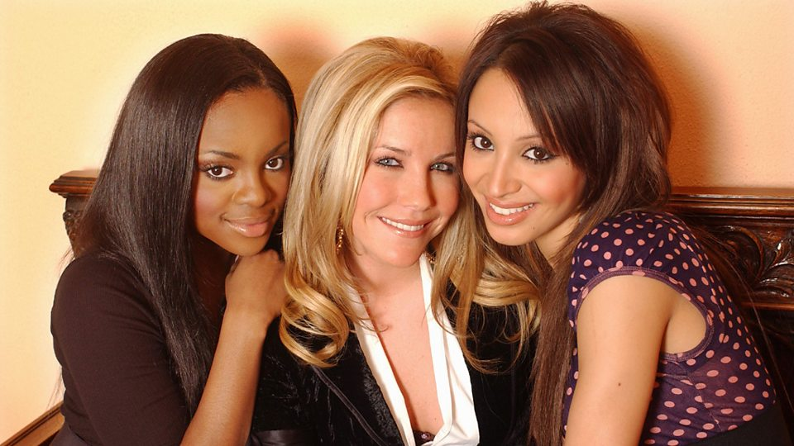
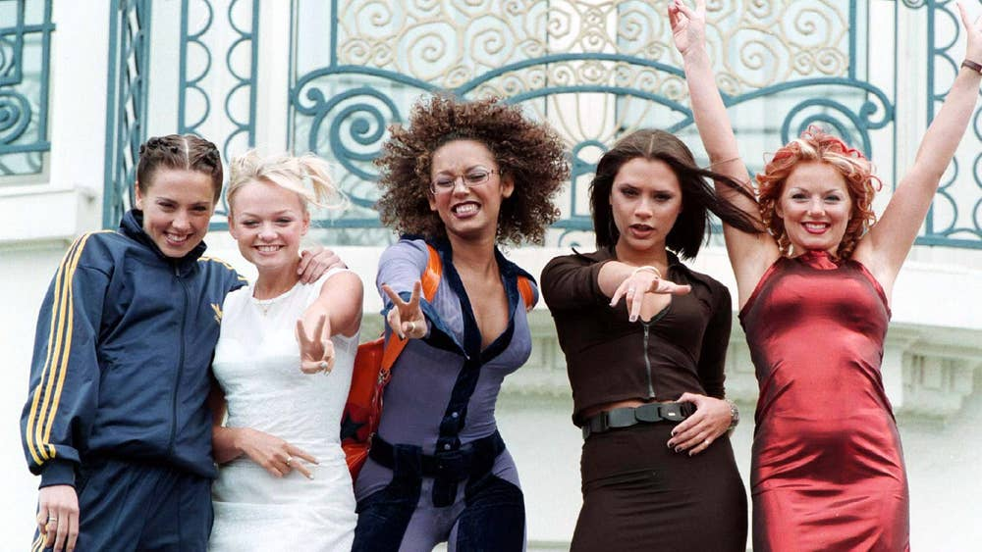
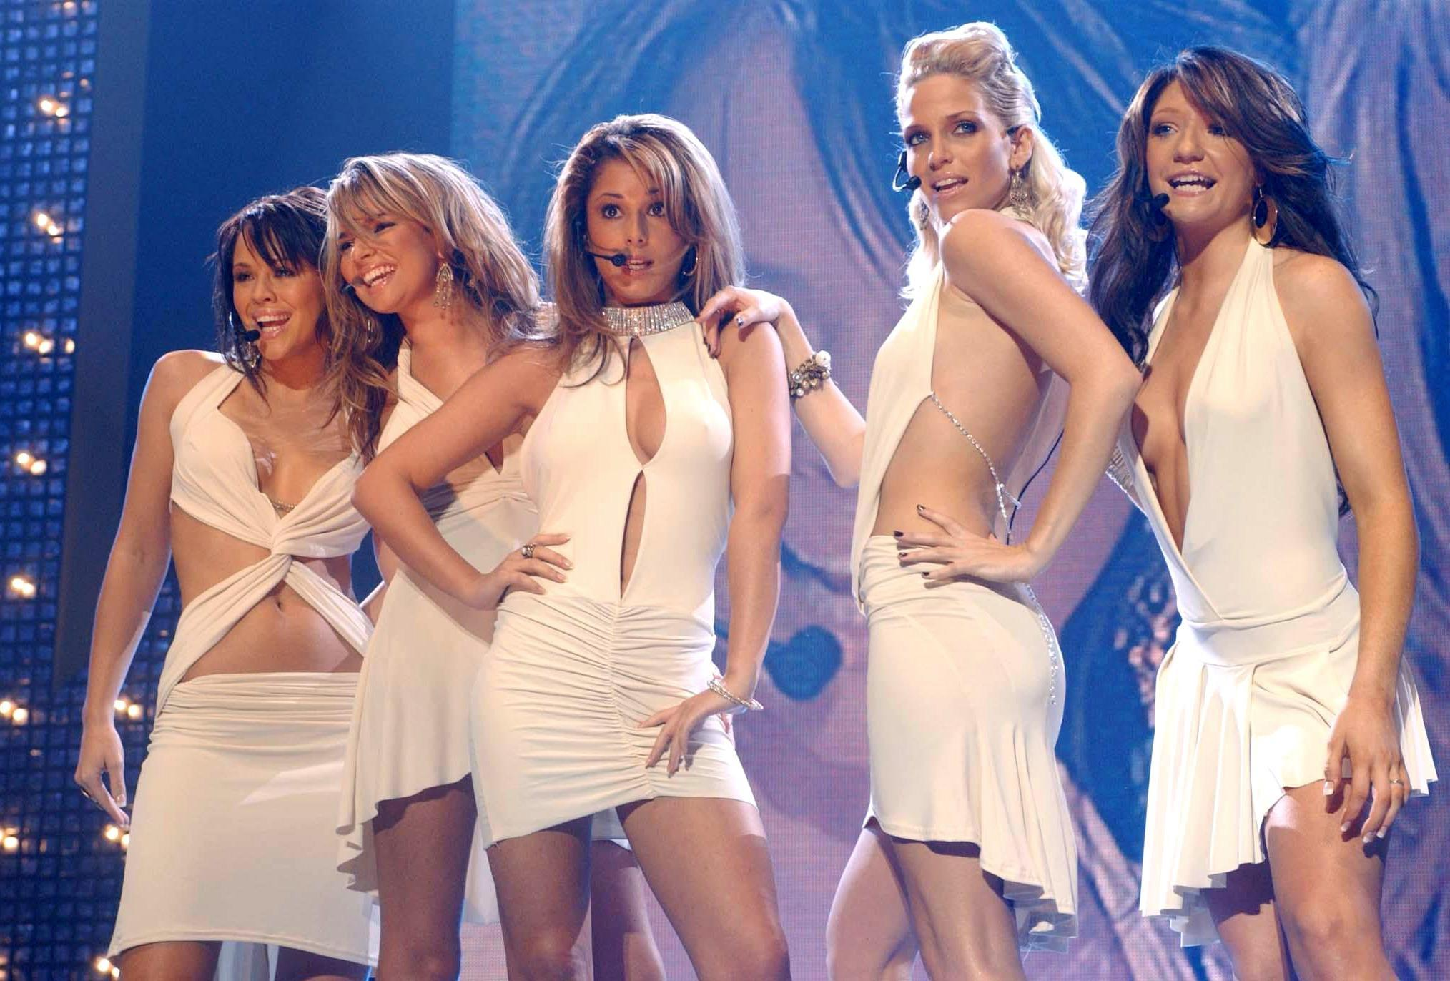
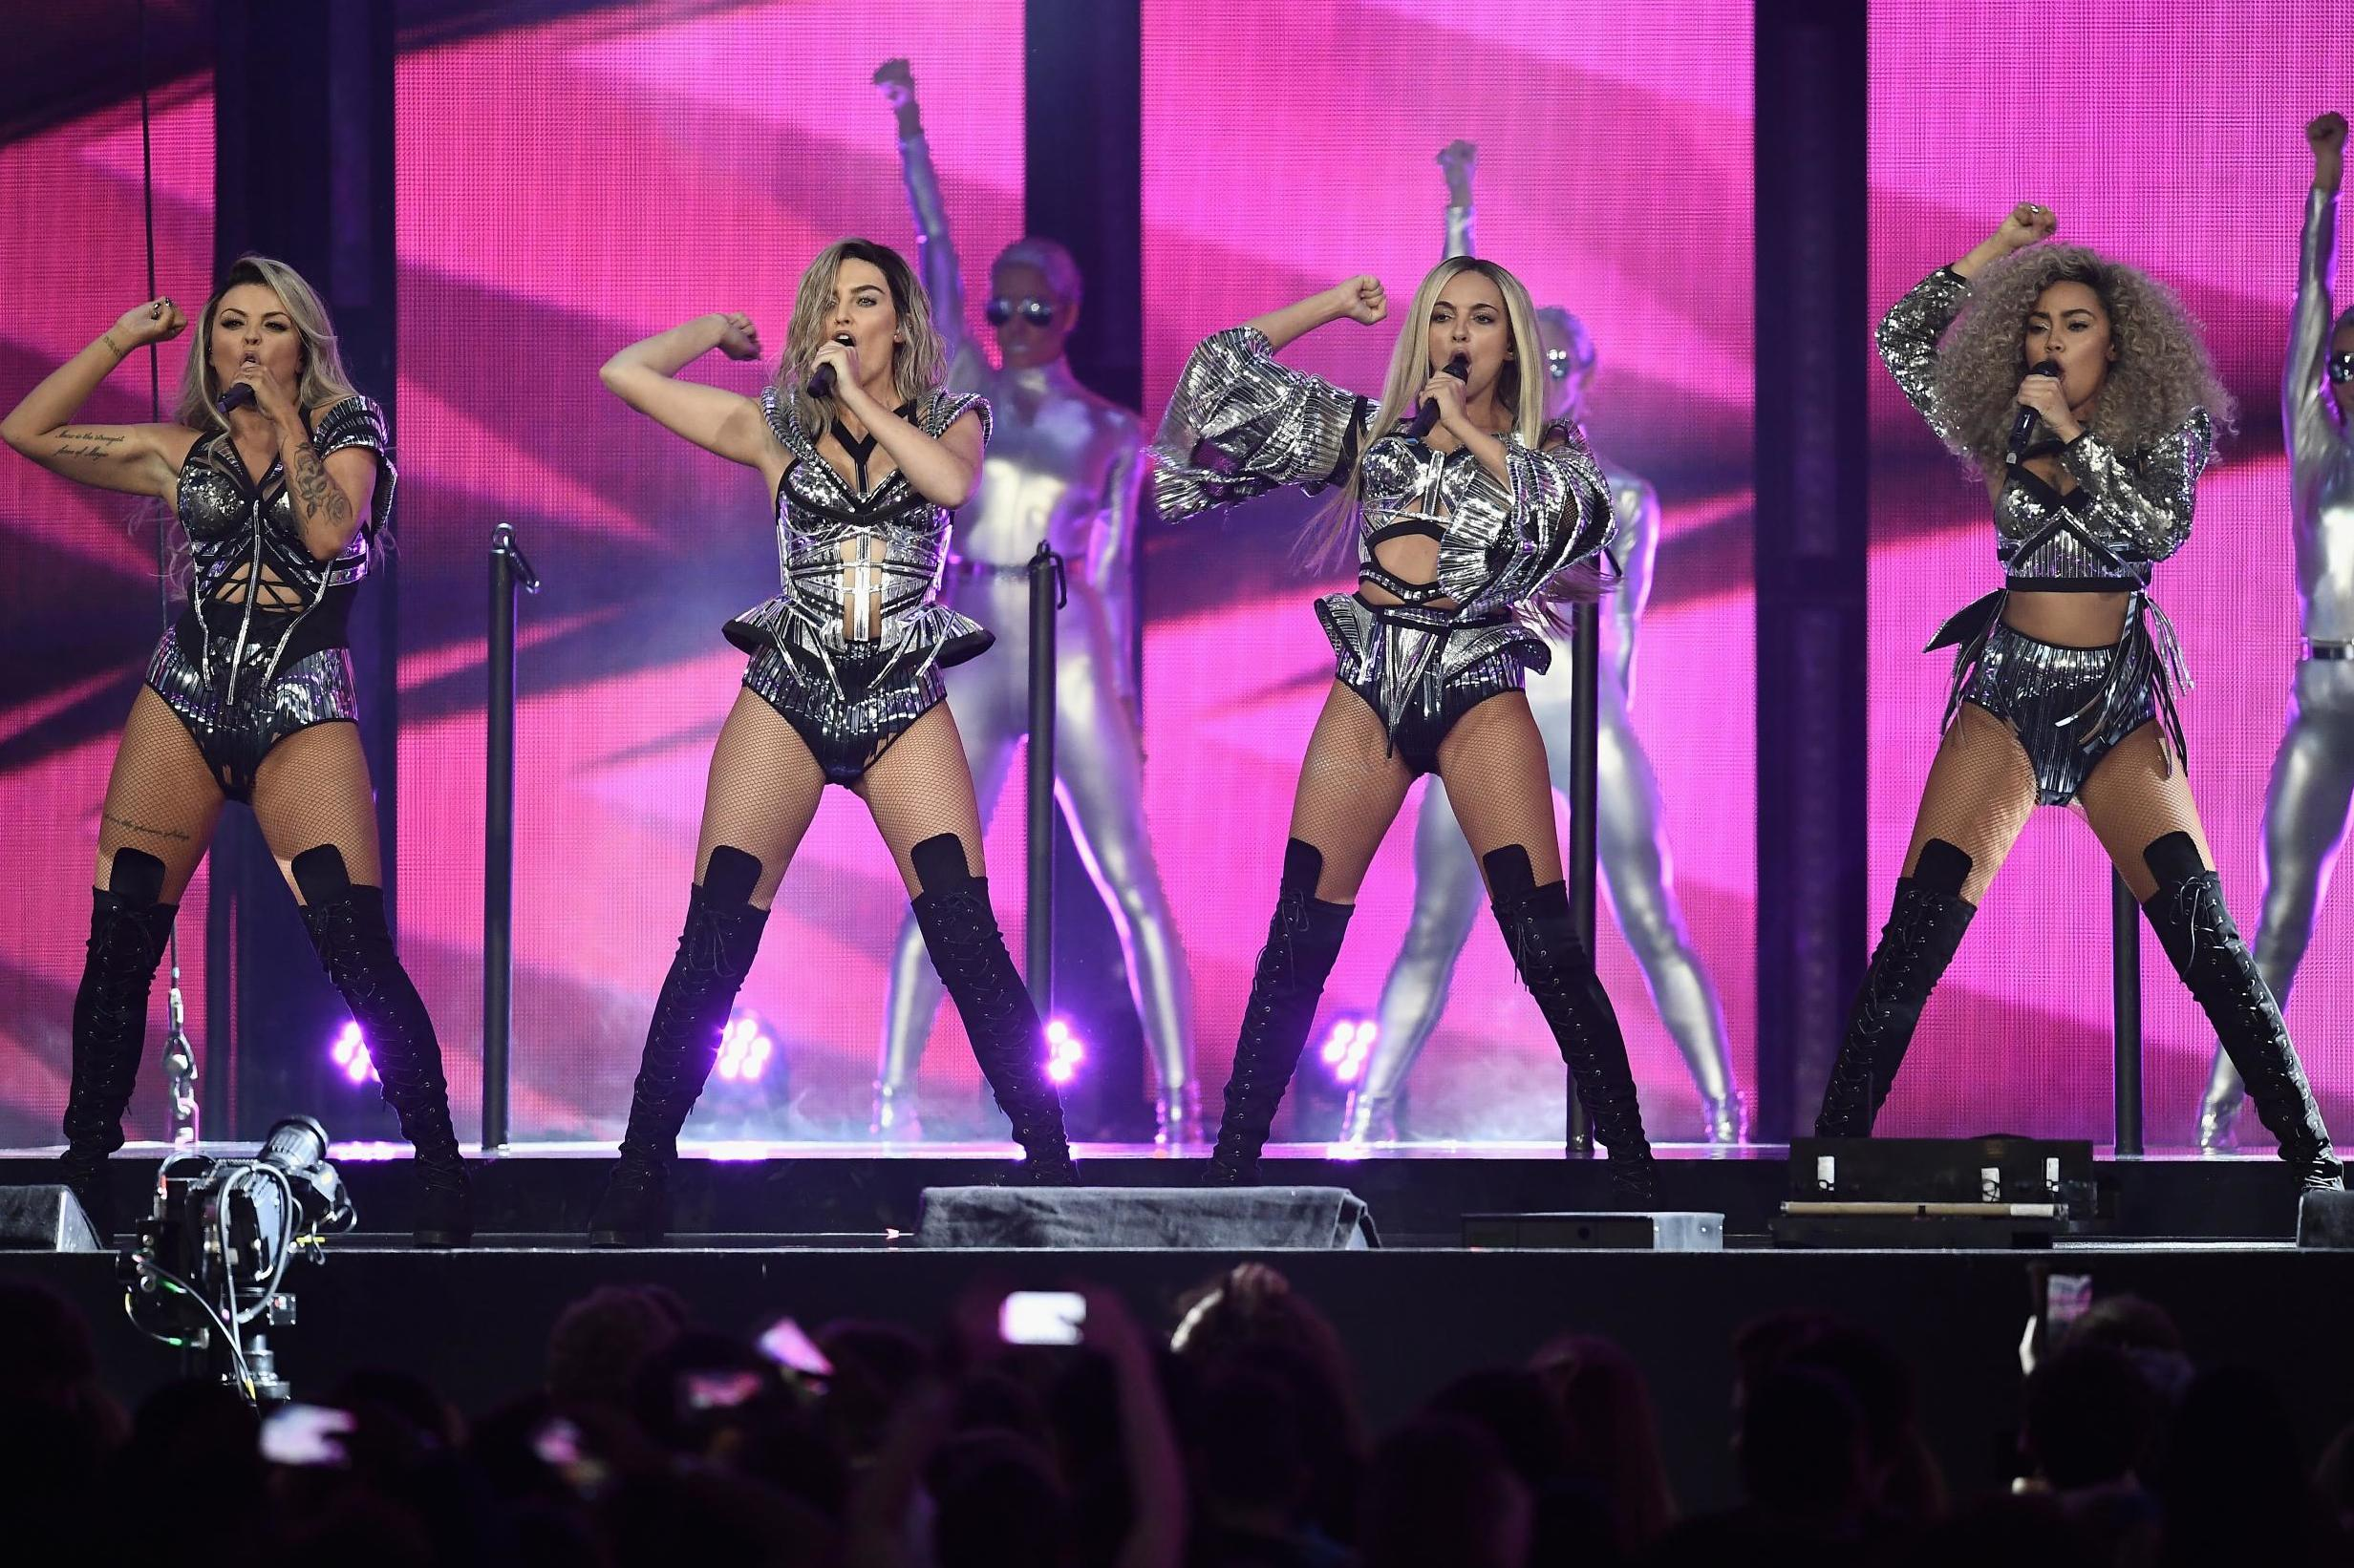
03. Girl Bands
B
1 Girls Aloud
2 Little Mix
3 Saturdays
4 Spice Girls
5 Sugababes
A
C
1 D
2 E
3 A
4 C
5 B
D
E

Slide 5
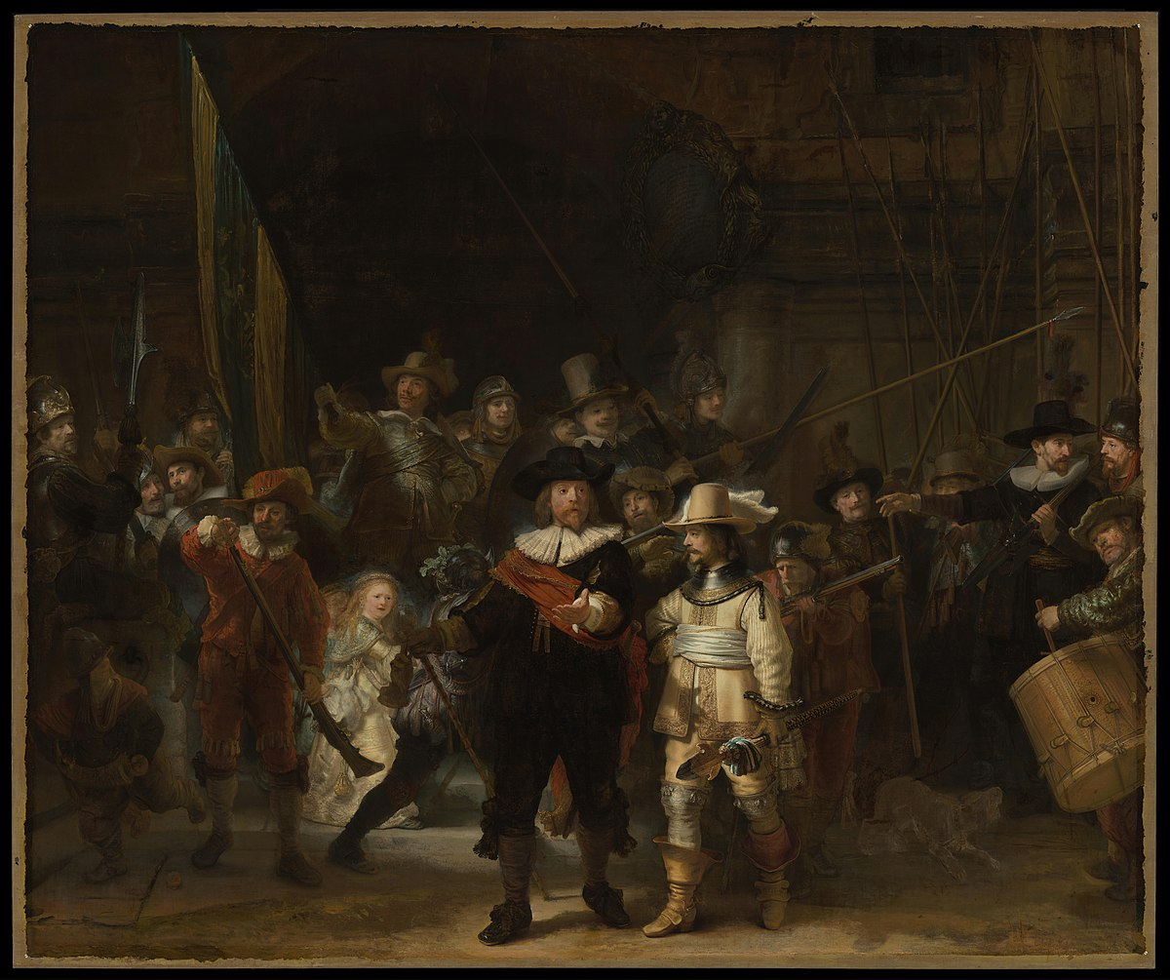

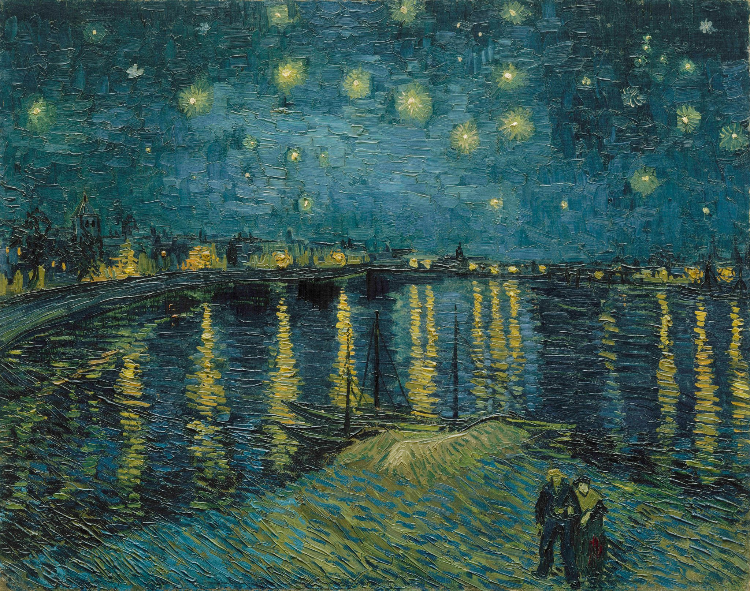
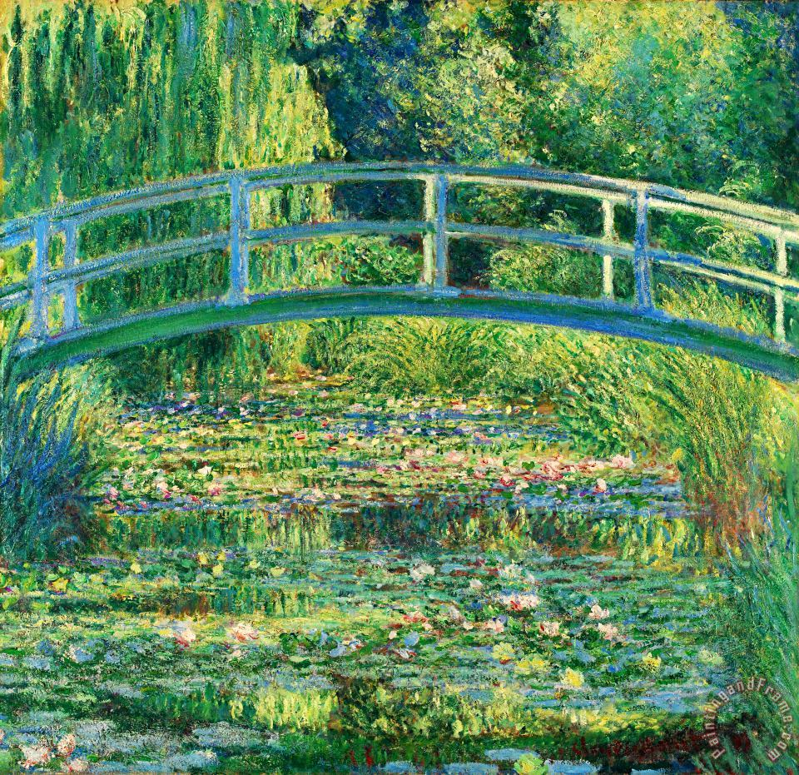

04. Artists
B
1 Matisse
2 Monet
3 Picasso
4 Rembrandt
5 Van Gogh
A
C
1 B
2 E
3 D
4 A
5 C
D
E

Slide 6
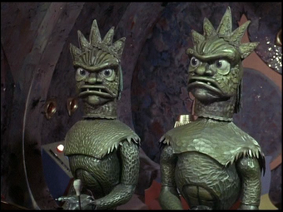
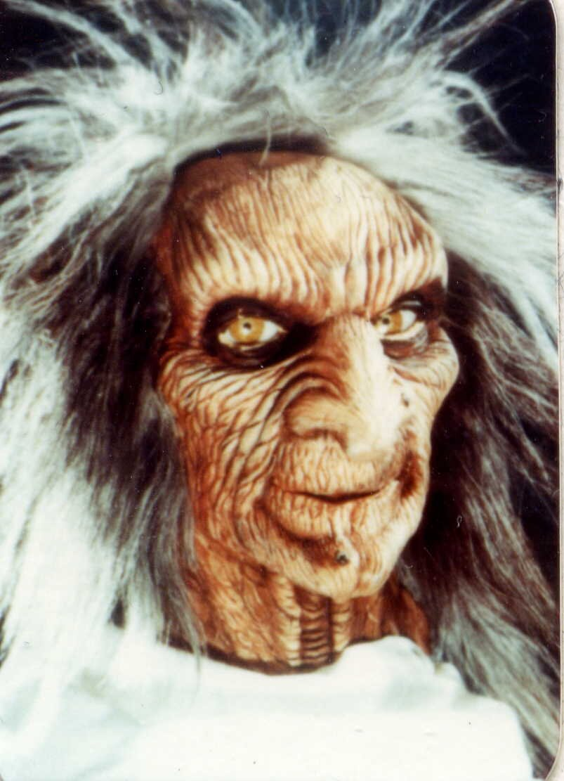

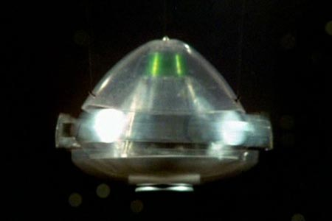
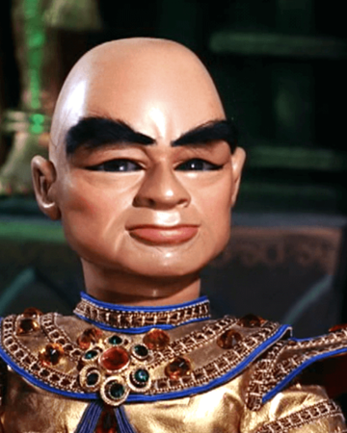
05. Gerry Anderson Enemies
B
1 Captain Scarlet
2 Stingray
3 Terrahawks
4 Thunderbirds
5 UFO
A
C
1 C
2 A
3 B
4 E
5 D
D
E

Slide 7




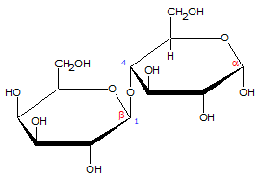
06. Chemicals (too easy!)
B
1 Aspirin
2 Caffeine
3 Lactose
4 LSD
5 Vitamin C
A
C
1 B
2 C
3 E
4 A
5 D
D
E

Slide 8
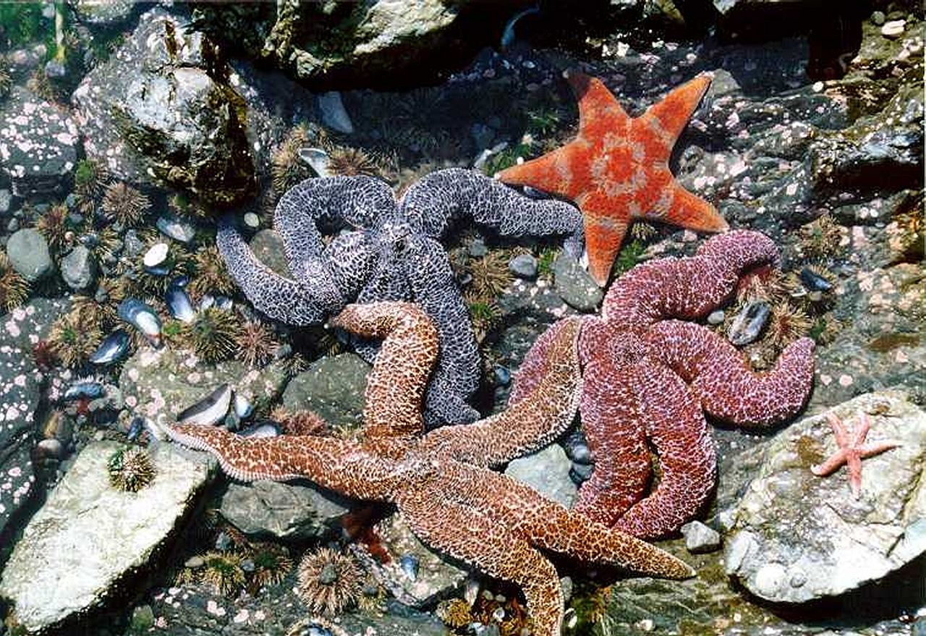
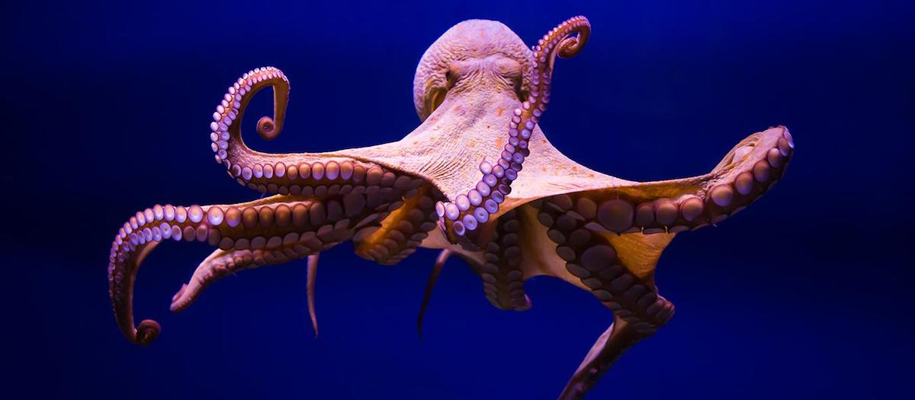
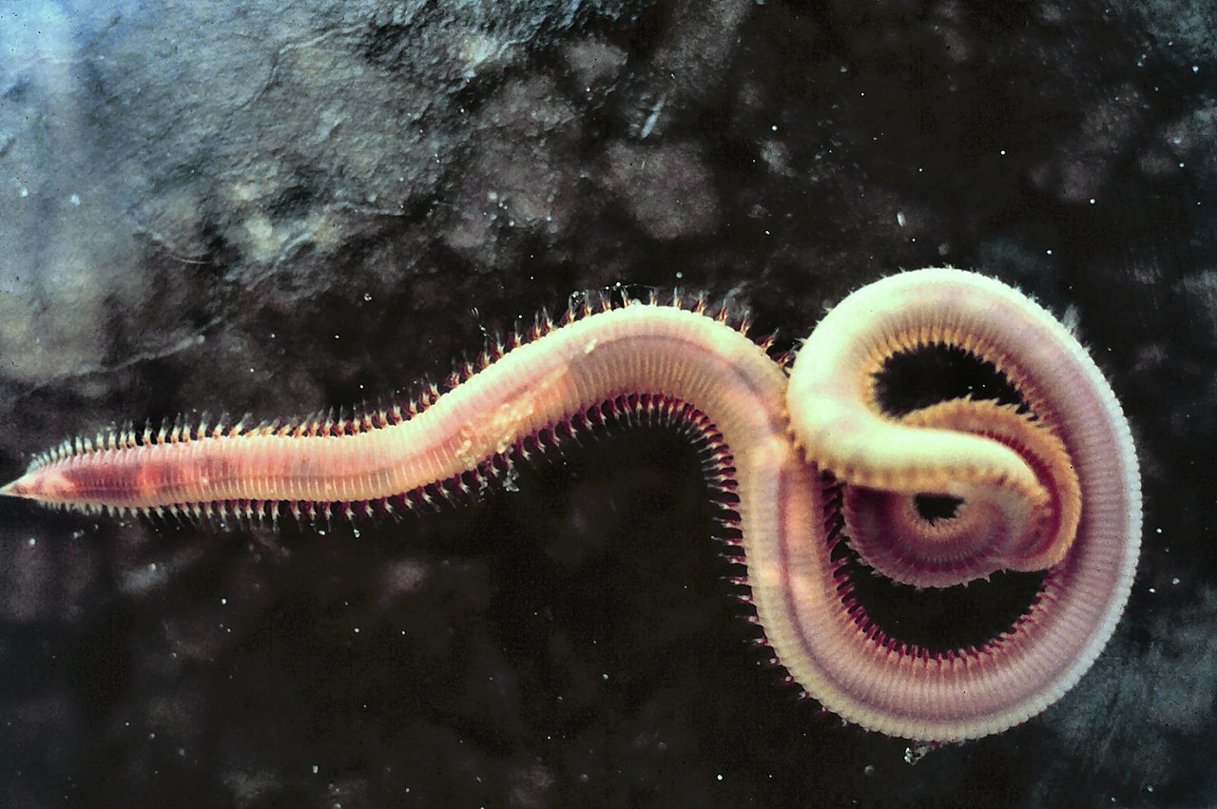
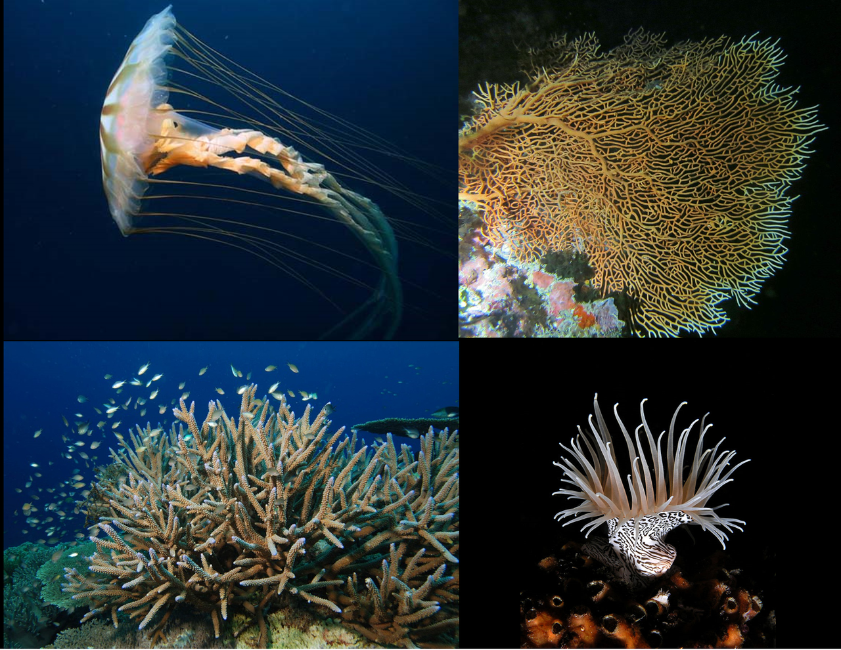
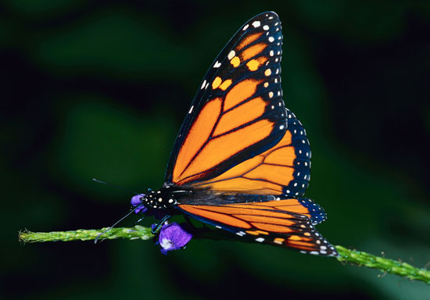
07. Invertebrate Phyla
B
1 Annelida
2 Arthropoda
3 Cnidaria
4 Echinodermata
5 Mollusca
A
C
1 C
2 E
3 D
4 A
5 B
D
E

Slide 9
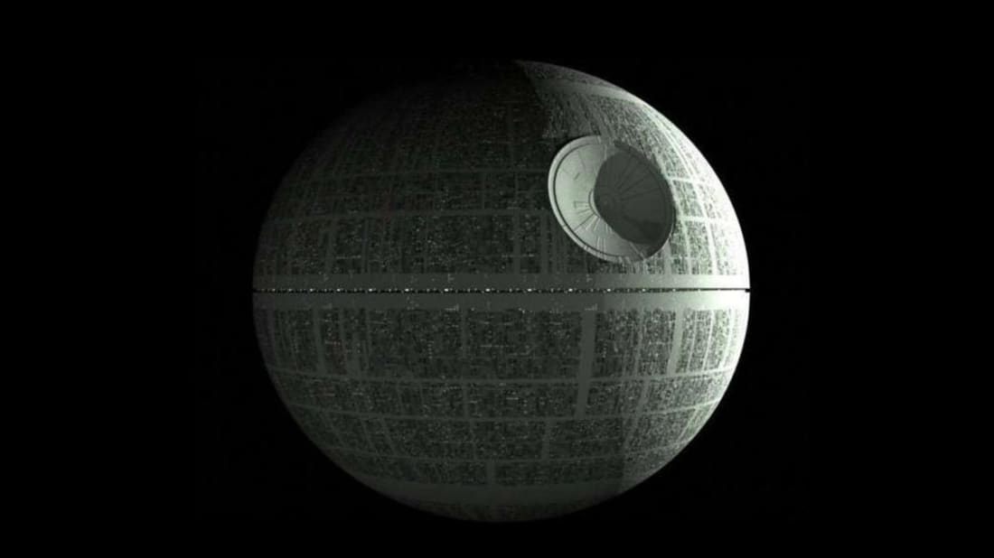

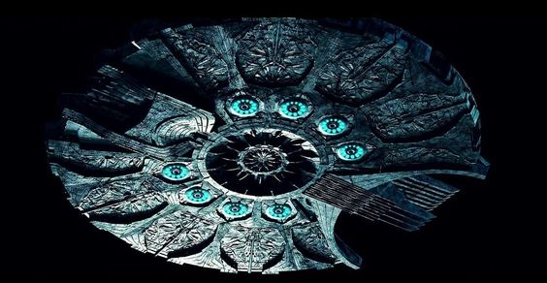
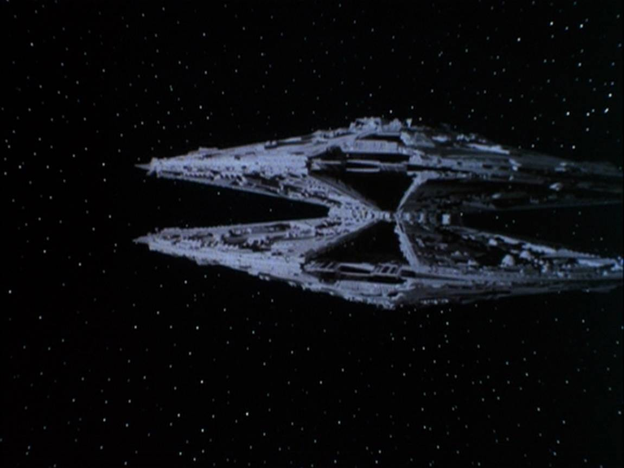
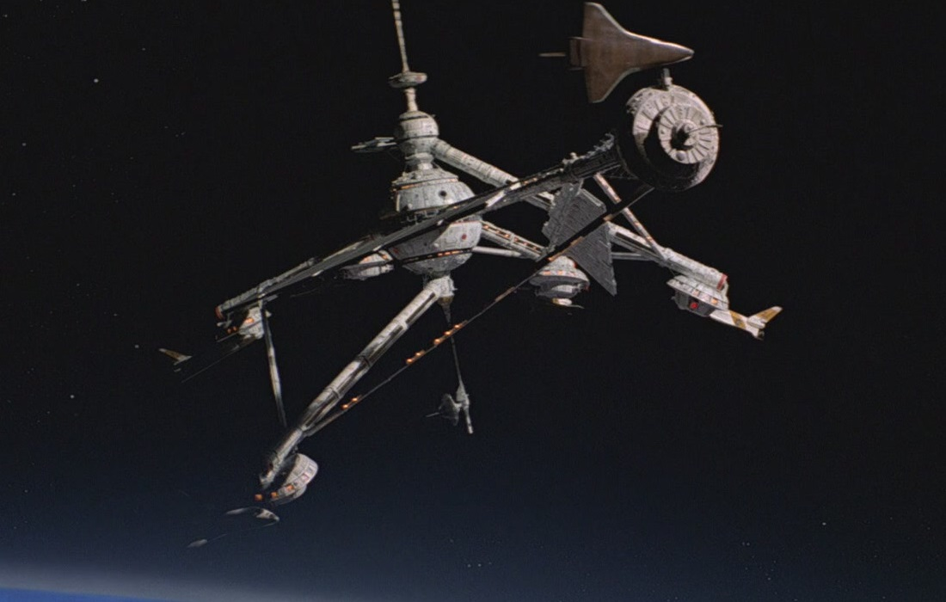
08. Enemy Spacestation
B
1 Battlestar Galactica
2 Independence Day
3 Moonraker
4 Star Trek
5 Star Wars
A
C
1 D
2 C
3 E
4 B
5 A
D
E

Slide 10
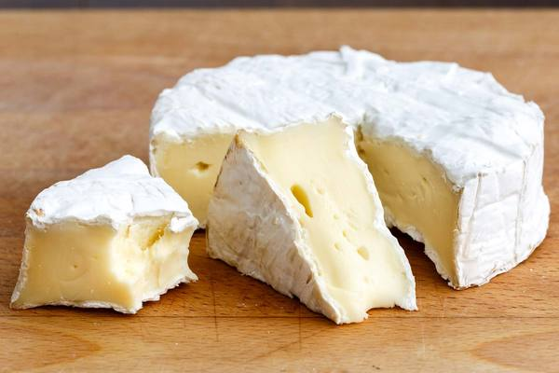
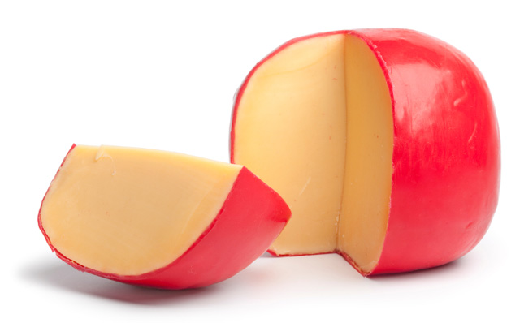
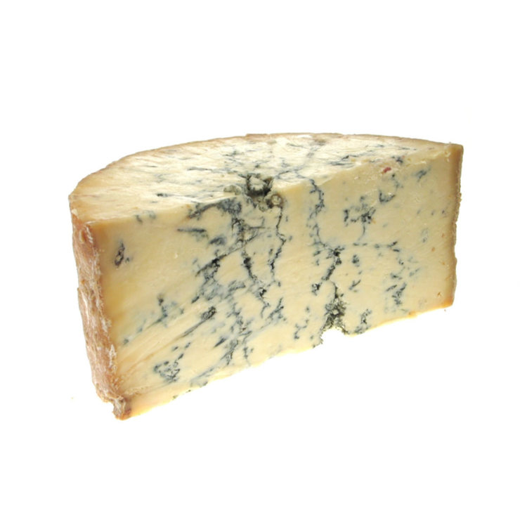

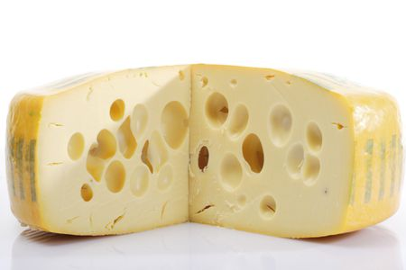
09. Cheese
B
1 American
2 Brie
3 Edam
4 Emmental
5 Stilton
A
C
1 D
2 B
3 A
4 E
5 C
D
E

Slide 11
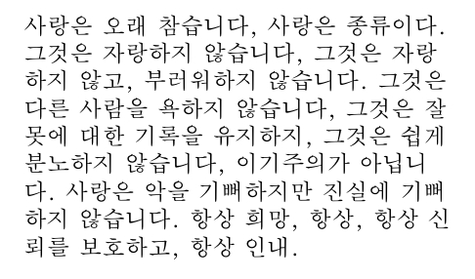
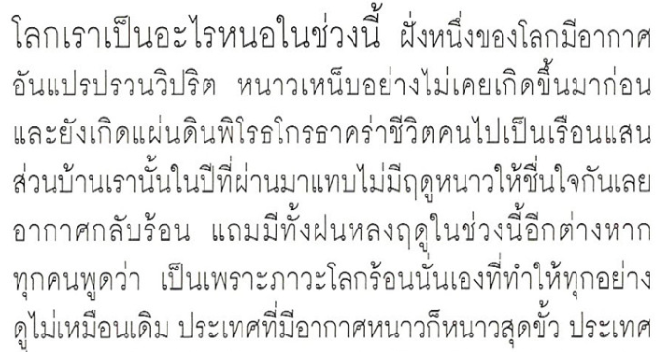



10. Writing
B
1 Chinese
2 Greek
3 Korean
4 Linear B
5 Thai
A
C
1 D
2 E
3 B
4 C
5 B
D
E

Slide 12
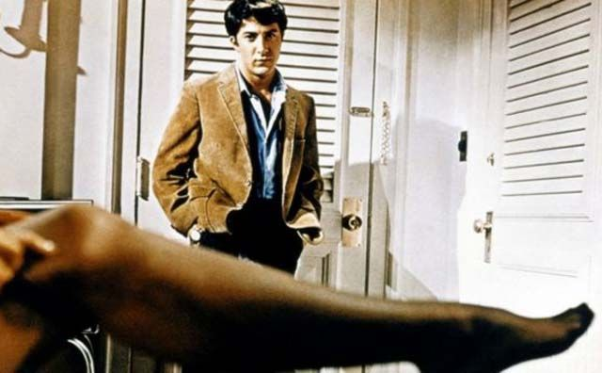
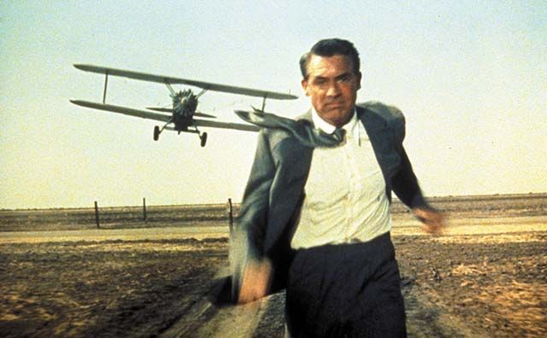
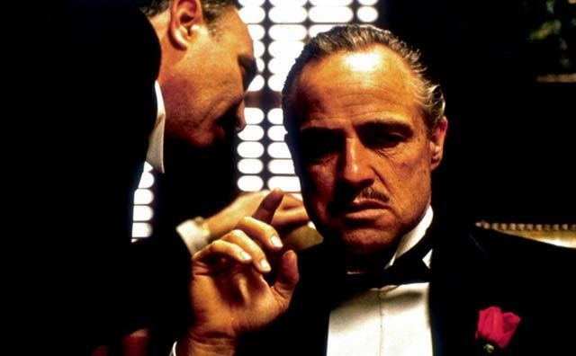
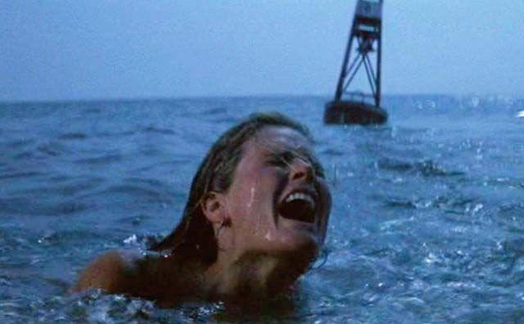
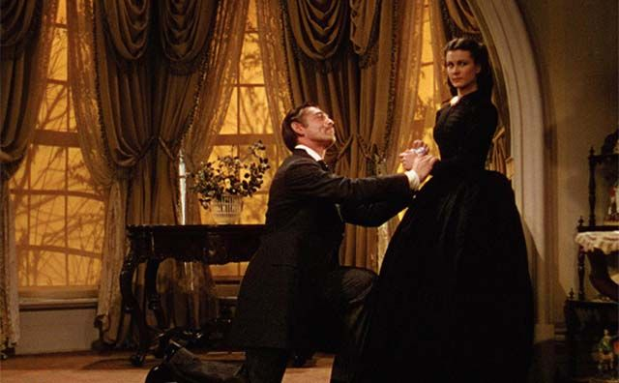
11. Iconic Movies
B
1 Gone with the Wind
2 Jaws
3 North by Northwest
4 The Godfather
5 The Graduate
A
C
1 E
2 D
3 A
4 C
5 B
D
E

Slide 13
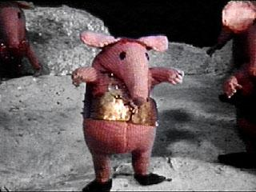
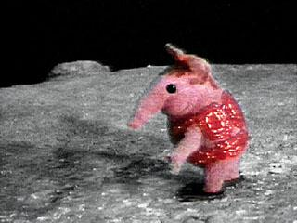
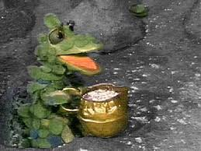
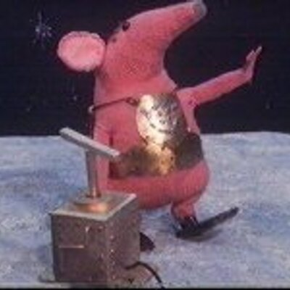
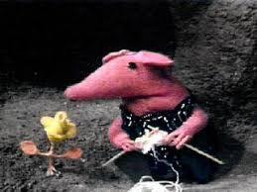
12. Clangers
B
1 Major Clanger
2 Mother Clanger
3 Small Clanger
4 The Soup Dragon
5 Tiny Clanger
A
C
1 E
2 D
3 A
4 D
5 B
D
E

Slide 14
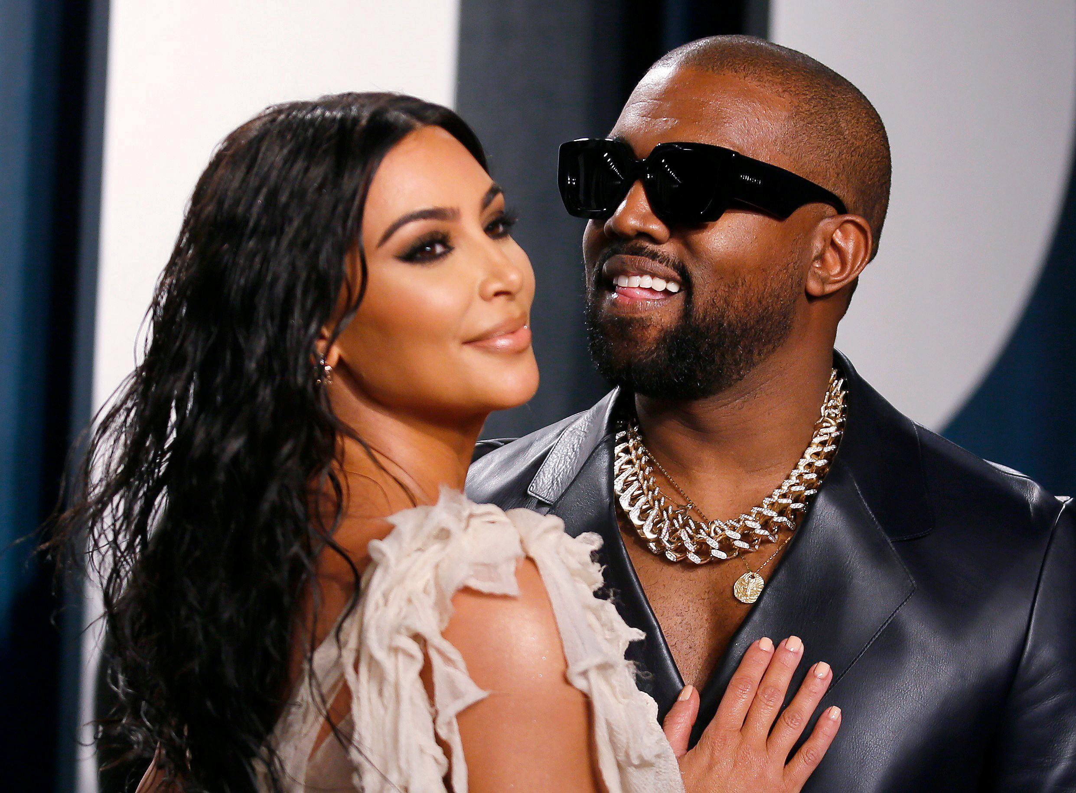
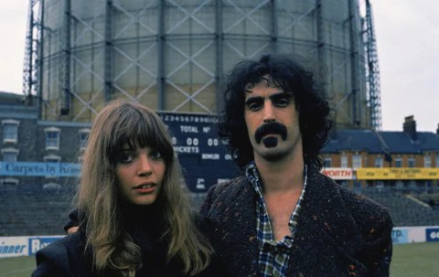
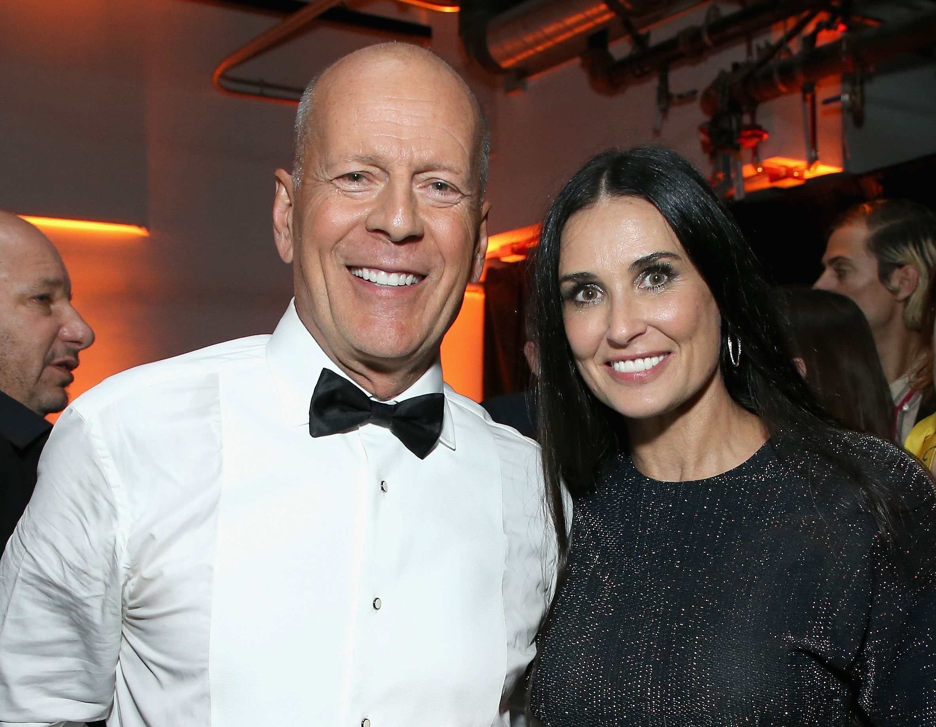
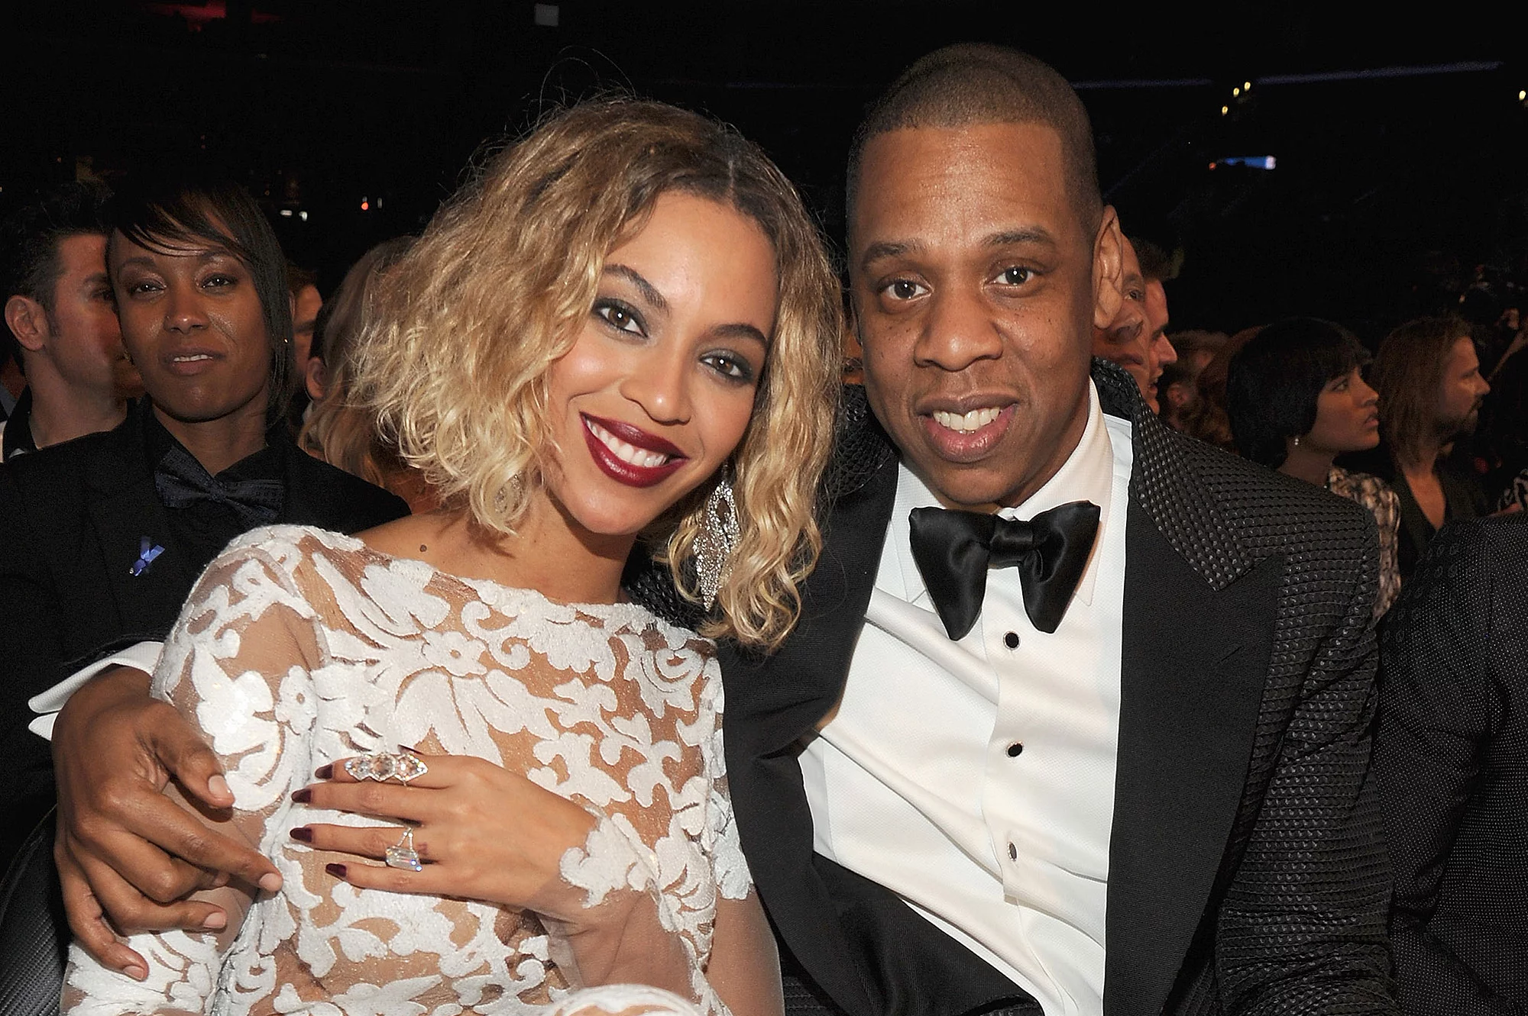
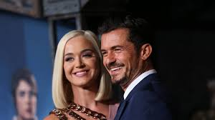
13. Who are the parents
B
1 Blue Ivy
2 Daisy Dove
3 Moon Unit
4 North
5 Rumer
A
C
1 D
2 E
3 B
4 A
5 C
E
D

Slide 15
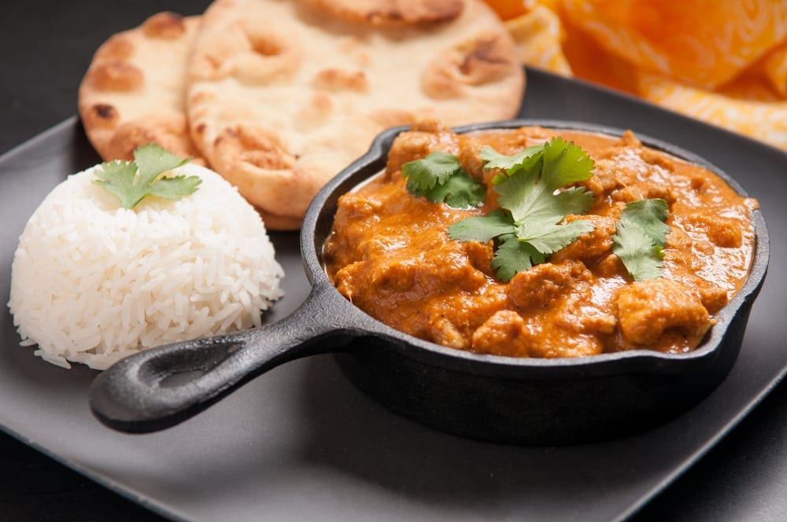




14. Name the curry
B
1 Biryani
2 Keema
3 Korma
4 Madras
5 Saag
A
C
1 D
2 E
3 A
4 B
5 E
D
E

